Slide 1
6502 Simulator
Collaborated on by:
Ben Badnani, William Wei, Ryan Velez, James Ngo

Slide 2
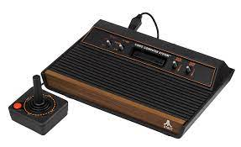
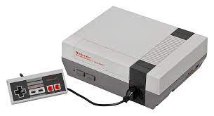
Recap from last presentation
Introduced in 1975
Well known consoles used either the 6502 or one of its variants
  Atari 2600
  Nintendo Entertainment System (NES)
Used the 6507.
Used the 6502.

Slide 3
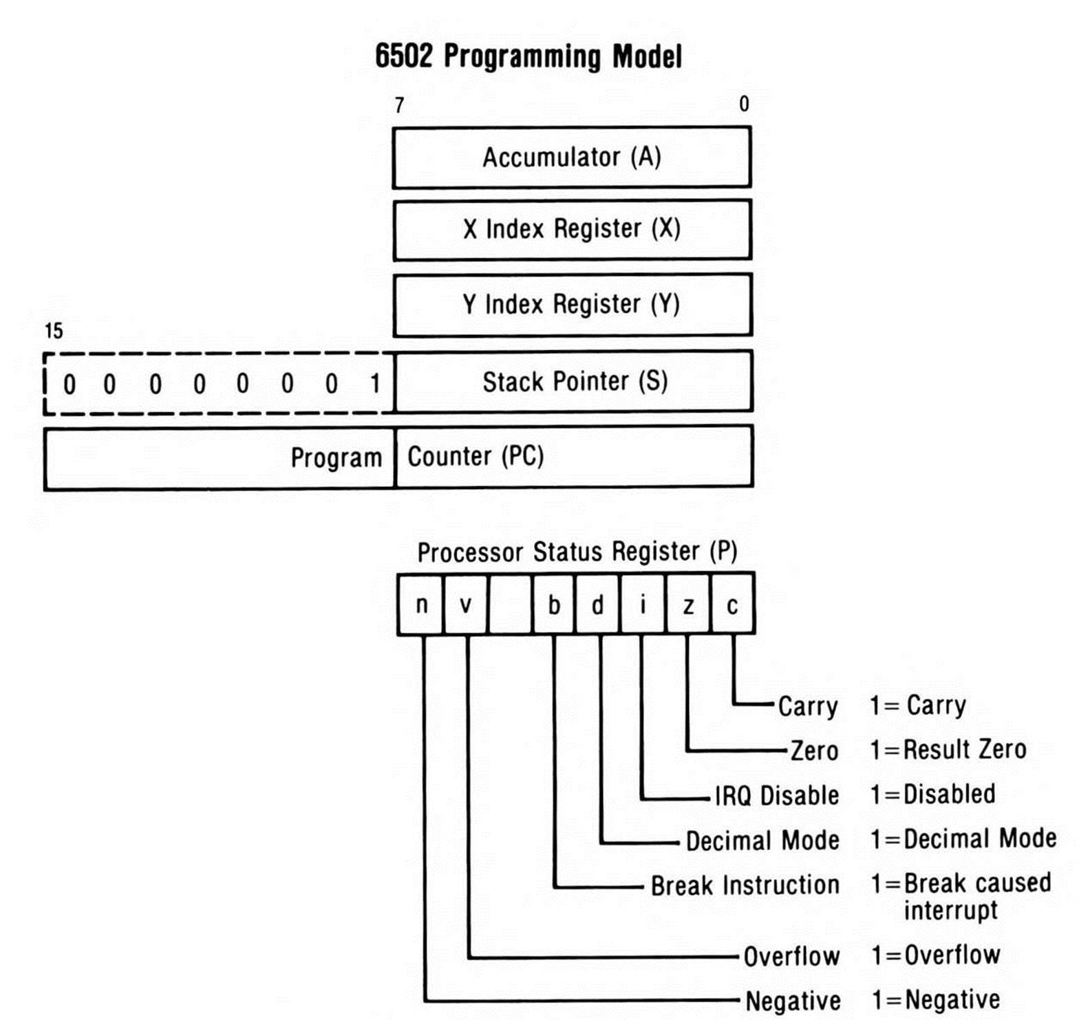
Hardware Recap
Very few registers
  One 8-bit accumulator
  Two 8-bit index registers, X and Y
  One 8 bit status register
  One 8 bit stack pointer
  One 16 bit program counter

Slide 4
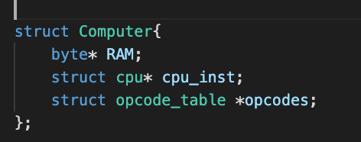
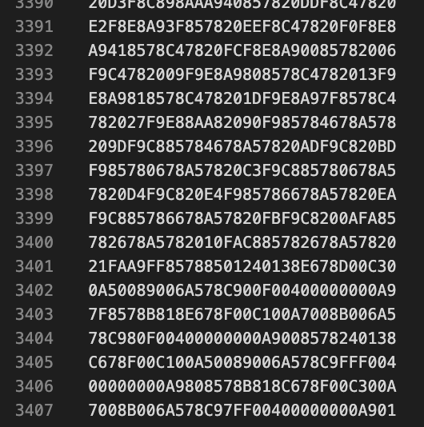
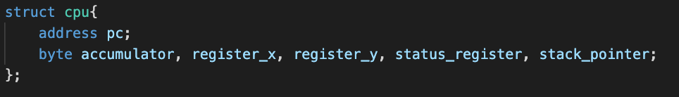
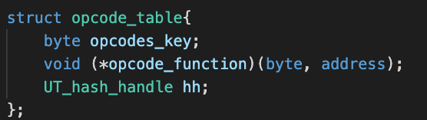
Simulator Setup

Slide 5
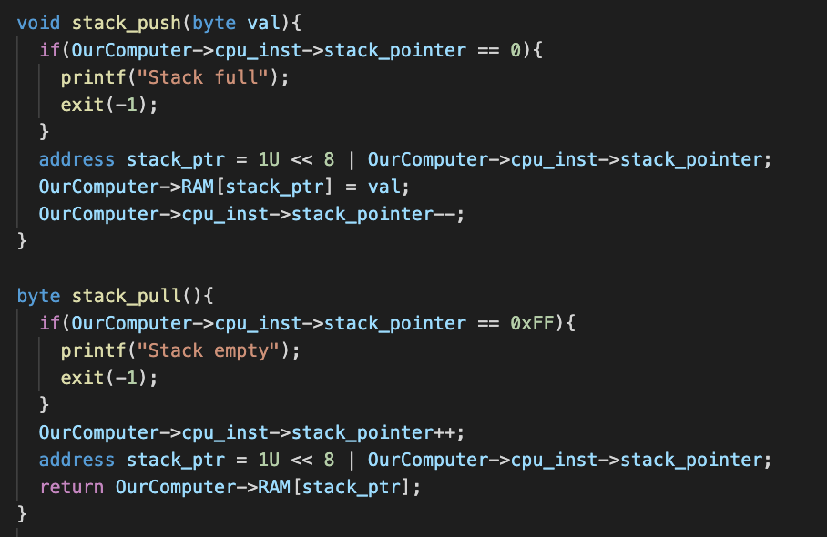
Simulator Setup

Slide 6
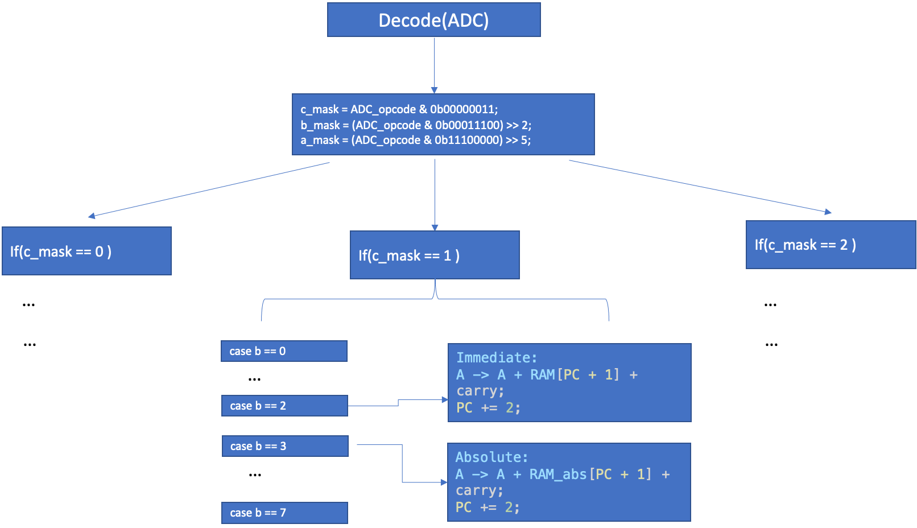
Method Architecture Recap
Fetch, Decode, Execute!
Fetch
Decode
4C F5 C5 A2 00 ..
Execute!!
Jmp $C5 F5

Slide 7
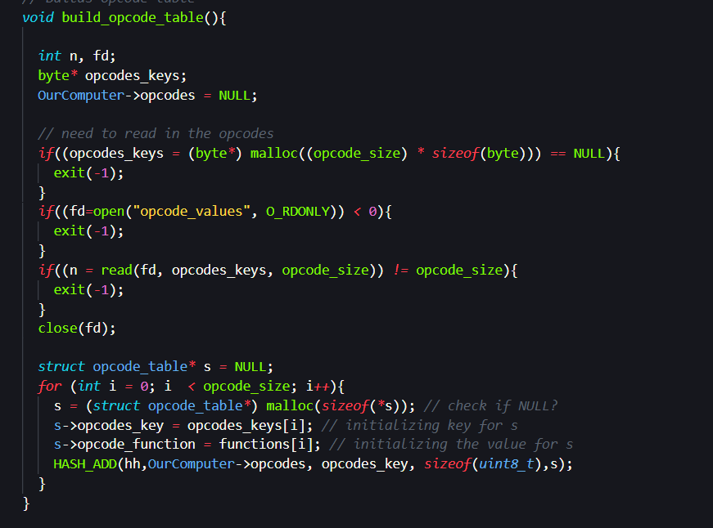
Fetch using UTHash
Build the hashtable to store function pointers

Slide 8
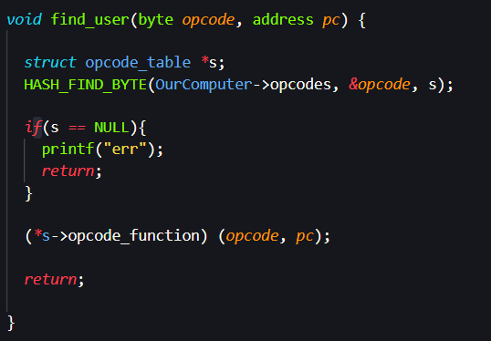
UTHash Continued
We can now invoke the correct function by reading in the opcode at the program counter

Slide 9
Decode ?
FUNCTION
HASH TABLE
ADC
ADC(opcode, address)
OPCODE
69
65
75
6D
7D
79
61
71
65
OUR BOY =
But what do the different opcodes for the same function ACTUALLY mean?
They tell us the
ADDRESSING MODE
REMEMBER THIS IS IN HEX

Slide 10
Addressing Modes, a breakdown
Group 01
Group 10
Group 00
000 -> (Zero page, x)
001 - Zero page
010 -> Immediate
011 -> Absolute
100 -> (Zero page), Y
101 -> Absolute, Y
111 -> Absolute, X
000 -> Immediate
001 -> Zero page
010 -> Accumulator
101 -> Zero page, X
111 -> Absolute, X
000 -> Immediate
001 -> Zero page
010 -> Absolute
101 -> Zero page, x
111 -> Absolute, x
HEXADECIMAL
BINARY
AAA BBB CC
65
01100101
011 001 01
OUR BOY =

Slide 11
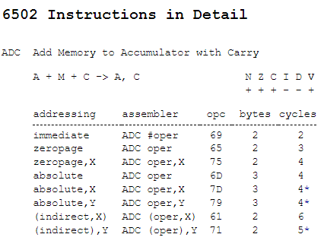
OUR BOY

Slide 12
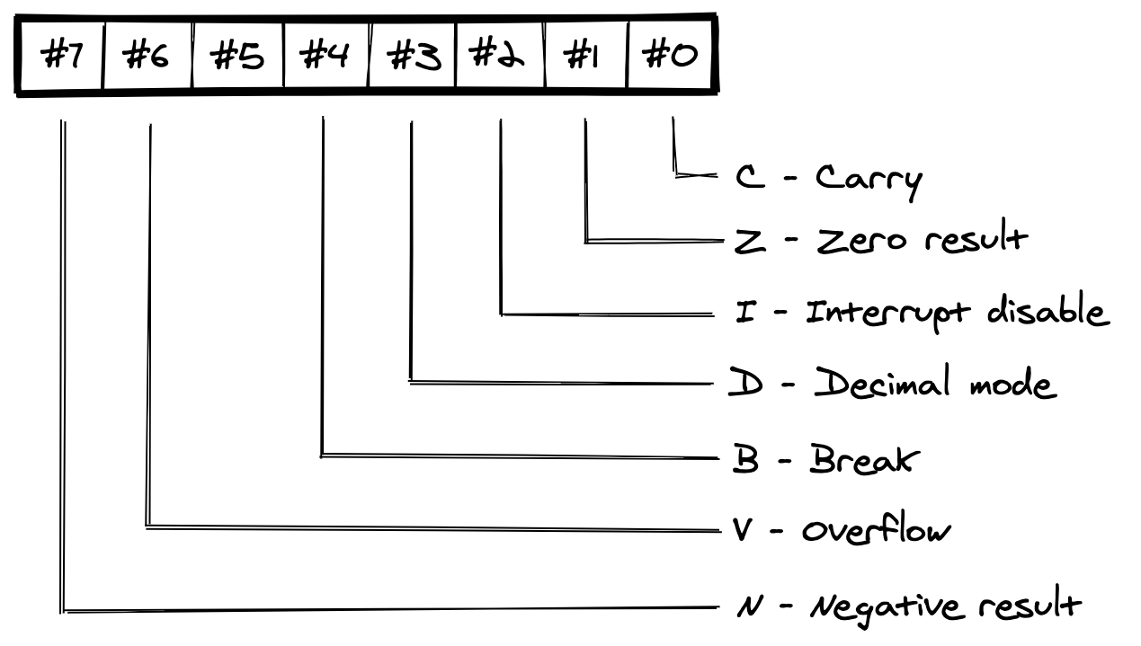
Status Register
Many of the opcodes set different flags in the status register
Functions can behave differently based on these flags

Slide 13
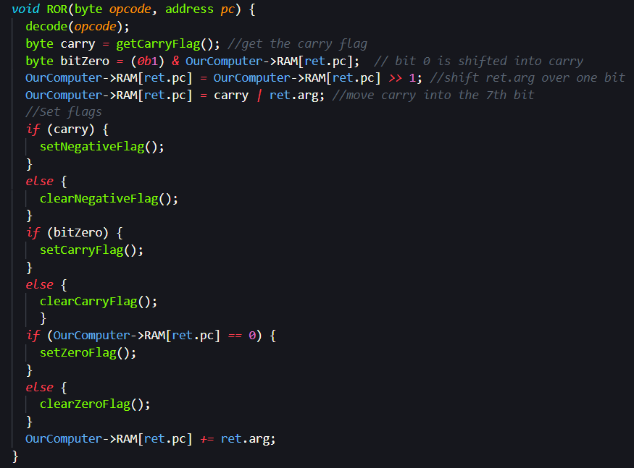
Functions setting flags
Rotate operand one bit to the right
  10100010 -> [c]010001
Updates the carry flag!
But also, updates the negative flag on input carry
Updates zero flag on operand == 0

Slide 14
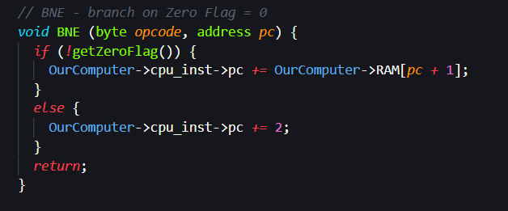
Branch Commands
Conditional jump

Slide 15
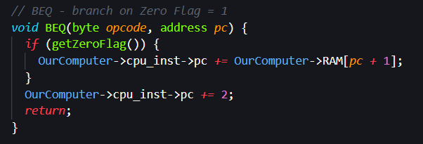
More Branch Commands
Notes:
Talk about compare and how this is essentially a JE

Slide 16
Stack and Stack Pointer Register
Created at addresses 0x100 - 0x1FF
Memory Map:
0x0000 - 0x00FF: Zero page
0x0100 - 0x01FF: Stack
0x0000-0x00FF
Zero - Page
0x0100-0x01FF
Stack
0x0200 -
RAM

Slide 17
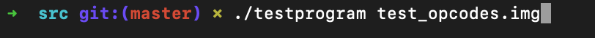
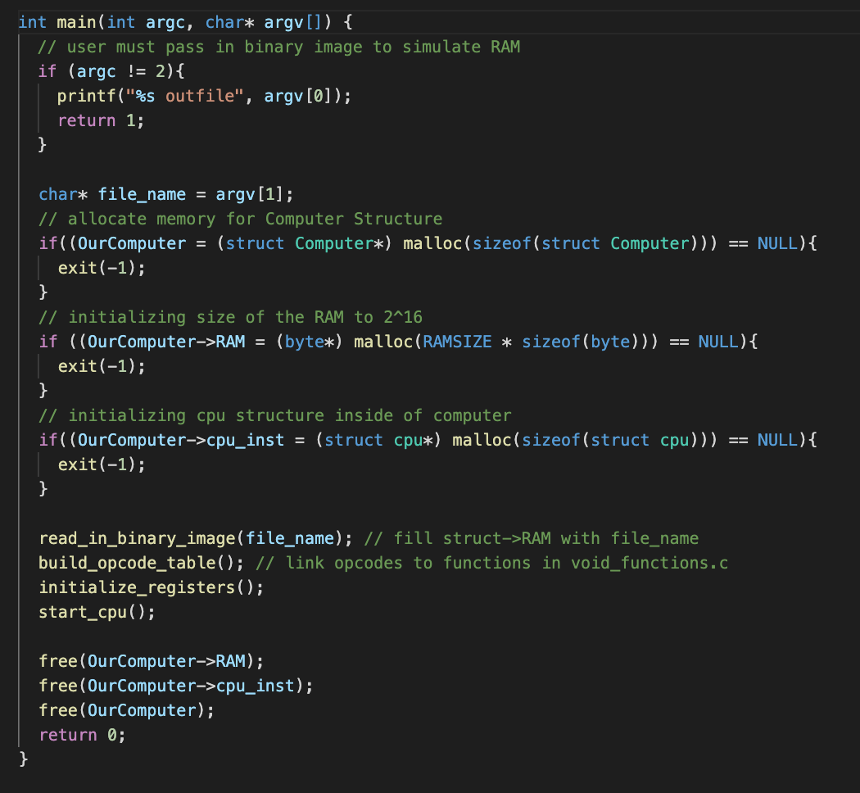
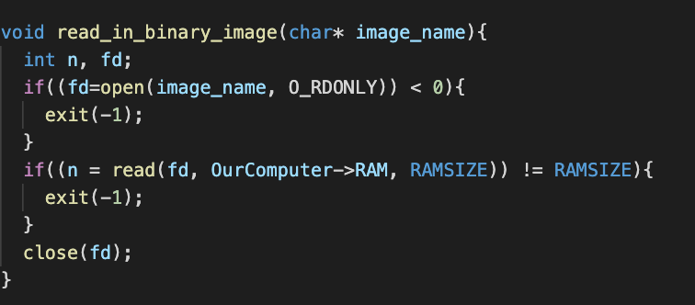
Running Instance of Simulator

Slide 18
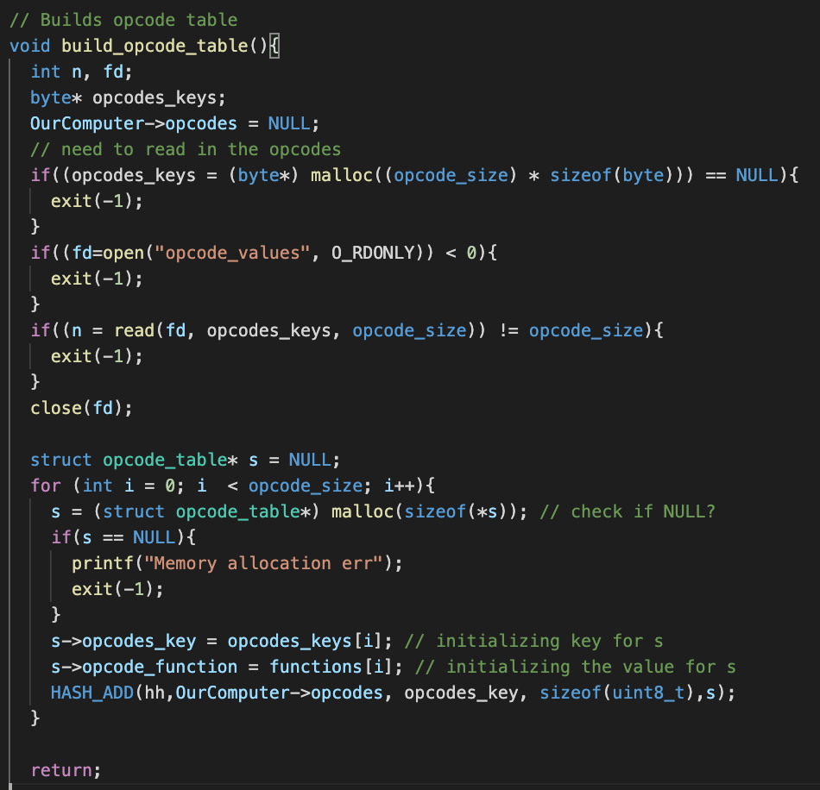
Running Instance of Simulator

Slide 19
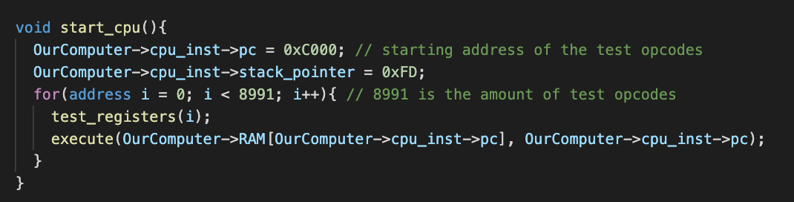
Running Instance of Simulator

Slide 20
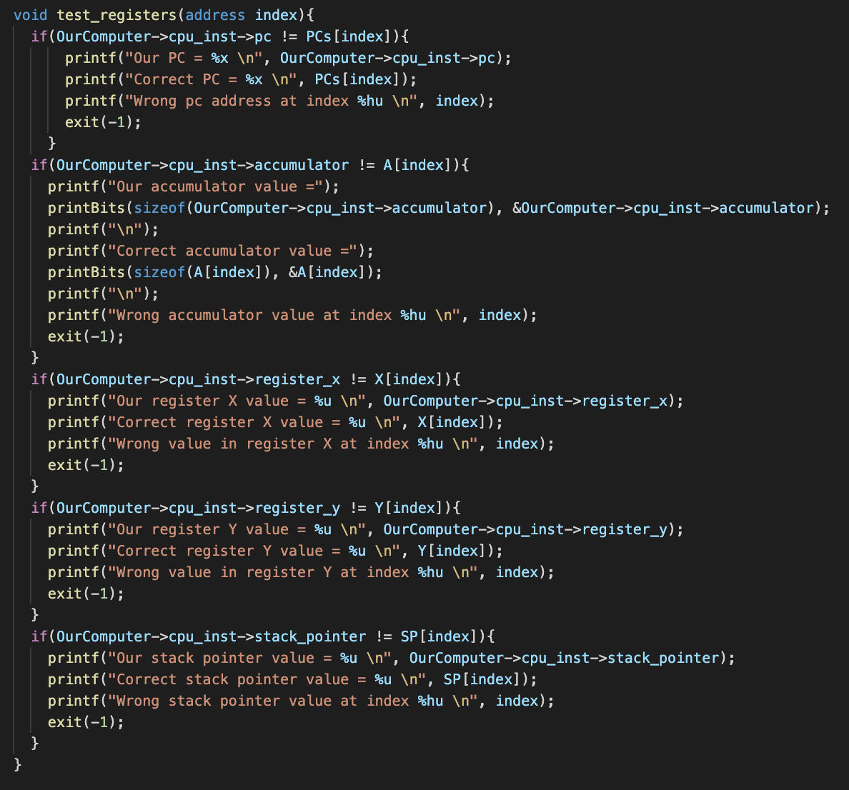
Running Instance of Simulator

Slide 21
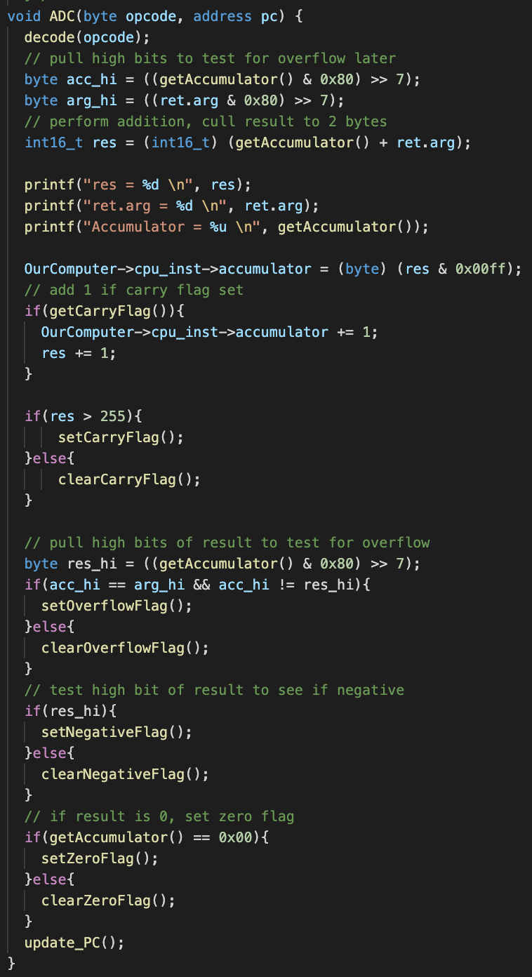
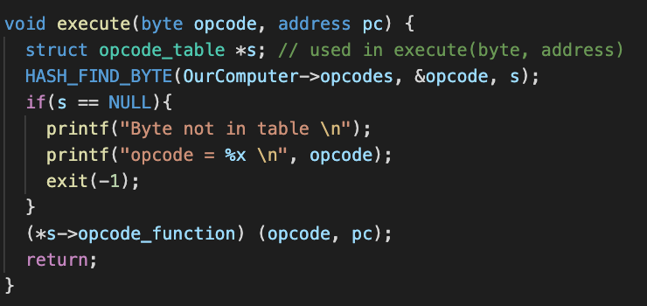
Running Instance of Simulator

Slide 22
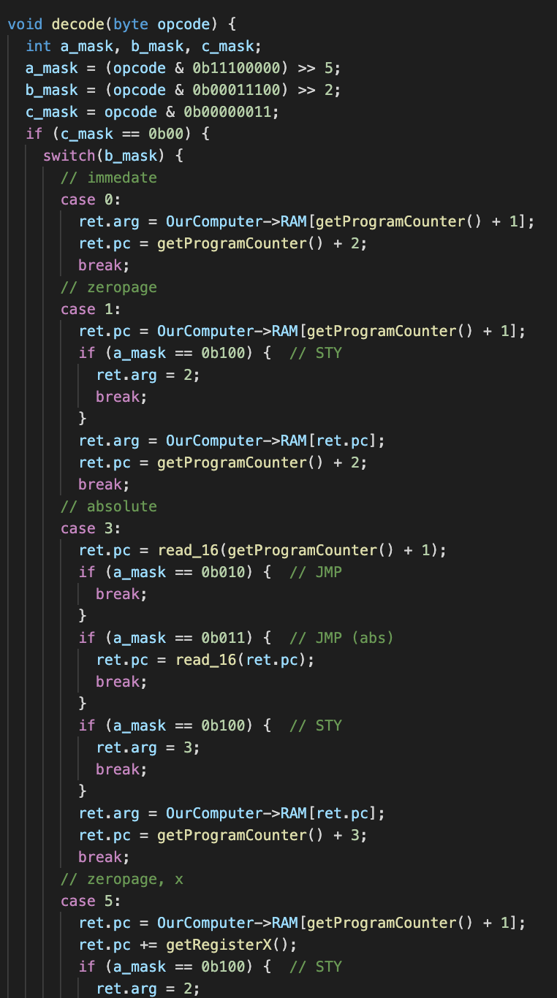
Running Instance of Simulator

Slide 23
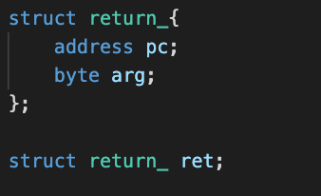
Running Instance of Simulator

Slide 24
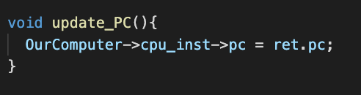
Running Instance of Simulator

Slide 25
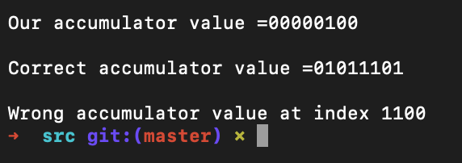
Running Instance of Simulator

Slide 26
Improvements
Could’ve attended more office hours
Could’ve had better time management and more consistent meetings
Could’ve been more proactive about integrating the webassembly feature

