Slide 1
Raspberry Pi Project
Surveillance Camera System
by
Jaydeep Chauhan

Slide 2
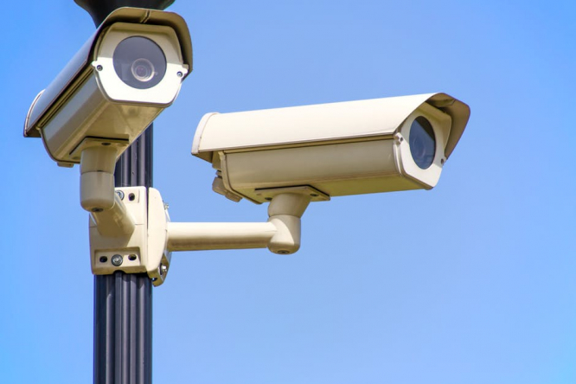
Motivation
Provide accessible security
Easy to create
Affordable option
https://www.connexionfrance.com/French-news/France-set-to-test-facial-recognition-security-cameras-says-junior-minister-after-successful-trials-in-Nice

Slide 3
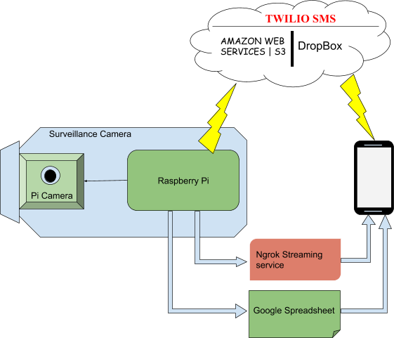
Design of the system
Block diagram

Slide 4
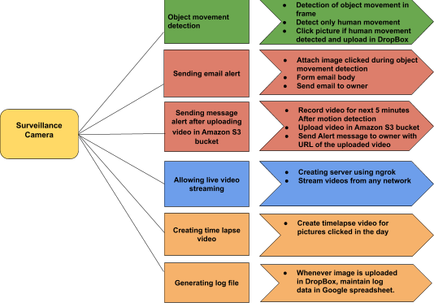
Project Plan

Slide 5
System Body
Body was 3D printed with help from UNIKAT, designed ourselves
Houses the raspberry pi 3 and camera module
Camera has 5 MP 1080p sensor
Includes infrared sensors for night vision

Slide 6

Spreadsheet Logs
Always working in background
Starts at Pi boot
Generates new file for each month, new sheet for each day
Appends new logs at the end if entry for the day exists already
Log of all events stored
Includes info about type of file, location
Contains clickable URL to file

Slide 7
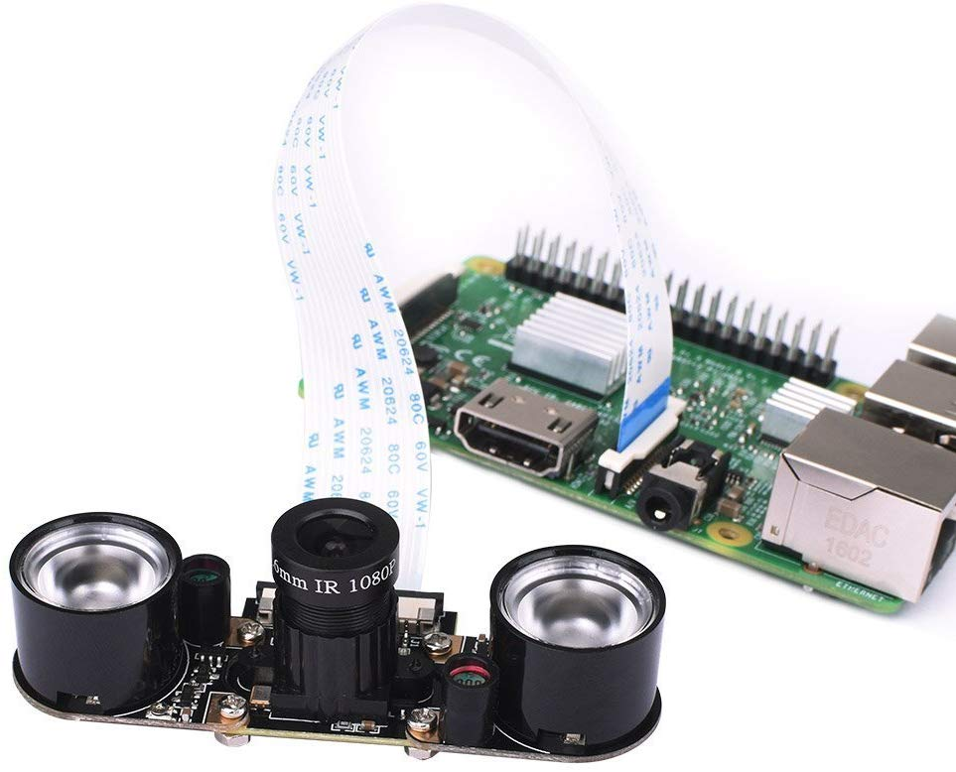
Camera Monitoring
Each frame processed for event detection
Frames saved every 15 sec as image for later use
Feed from camera also stored in a buffer for later use
Video recording started upon event trigger
Video appended to buffer feed

Slide 8

Sending alerts
After video recording, email and SMS alerts sent
Email sent through simple SMTP server
Twilio used to send SMS
Alerts contain message along with image upon event detection with time stamp and URL to video on dropbox

Slide 9



Streaming & Cloud Storage
All images, videos from event triggers stored on cloud
Services like Ngrok, Pagekite and Serveo used to livestream remotely
Serveo and Pagekite are free, ngrok requires subscription for remote streaming

Slide 10
Timelapse video
Created on demand
Can be made for any time of day selected by user
Images saved from camera stitched together to make timelapse
Video stored on cloud after creation

Slide 11
Conclusion
Surveillance system successfully designed
Records images and videos
Sends email and SMS alerts on detecting people
Can livestream camera feed
Makes a timelapse video
Stores images and videos on the cloud
Keeps a log of all activities

Slide 12

https://www.slideegg.com/thank-you-slide-for-ppt-2056

Slide 13

https://www.vectorstock.com/royalty-free-vector/any-questions-vector-7478164

Slide 14
References
[1]. Raspberry Pi Documentation https://www.raspberrypi.org/
[2]. A. Mansell, "Getting Started with Raspberry Pi: Installing Raspbian," Raspberry Pi, 14 January 2014.
[3]. Source on security camera installation cost: https://www.dksecurity.net/security-camera-installation-cost/
[4]. The Inquirer, "Raspberry Pi Model B+ review," The Inquirer, 30 July 214: http://www.theinquirer.net/inquirer/review/2357623/raspberry-pi-model-b-review.
[5]. Pi setup and basic guides https://www.pyimagesearch.com/
[6]. Security camera example with ngrok https://www.hackster.io/hackershack/smart-security-camera-90d7bd

Slide 15
References
[7]. Ngrok port forwarding documentation https://ngrok.com/
[8]. Pagekite documentation http://pagekite.net/
[9]. Serveo documentation http://serveo.net/
[10]. Integrating Google Sheets with Raspberry Pi https://developers.google.com/sheets/
[11]. Amazon AWS service setup guide for storing videos from Raspberry Pi to S3 bucket https://docs.aws.amazon.com/quickstarts/latest/s3backup/step-1-create-bucket.html
[12]. Dropbox integration with Raspberry Pi https://www.dropbox.com/developers/apps/create
[13]. Flask API for creating SMTP servers https://flask.palletsprojects.com/en/1.1.x/api/
[14.] Twilio API for SMS service https://www.twilio.com/

