Slide 1
Increment 3
Group 44

Slide 2
Application

Slide 3
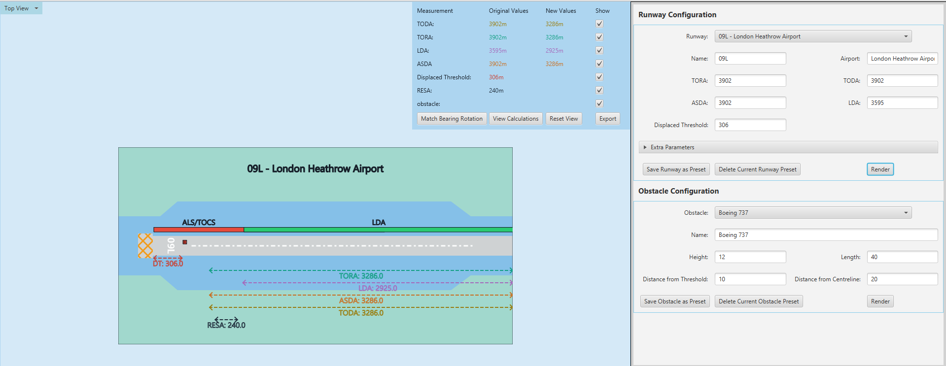
Correct + Value + Fit For Purpose
Can re-calculate TORA/TODA/ASDA/LDA and show visually.

Slide 4
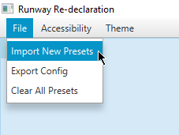
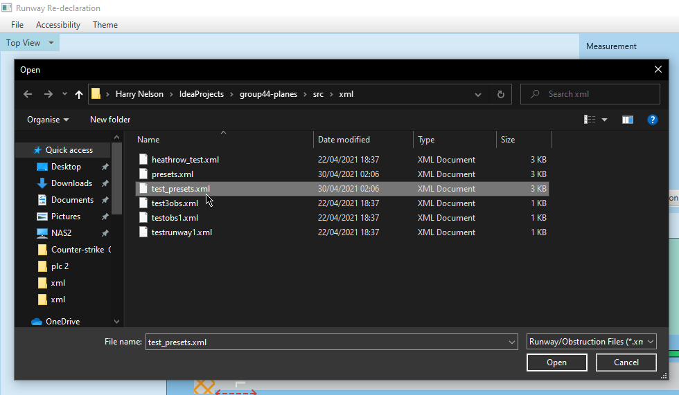
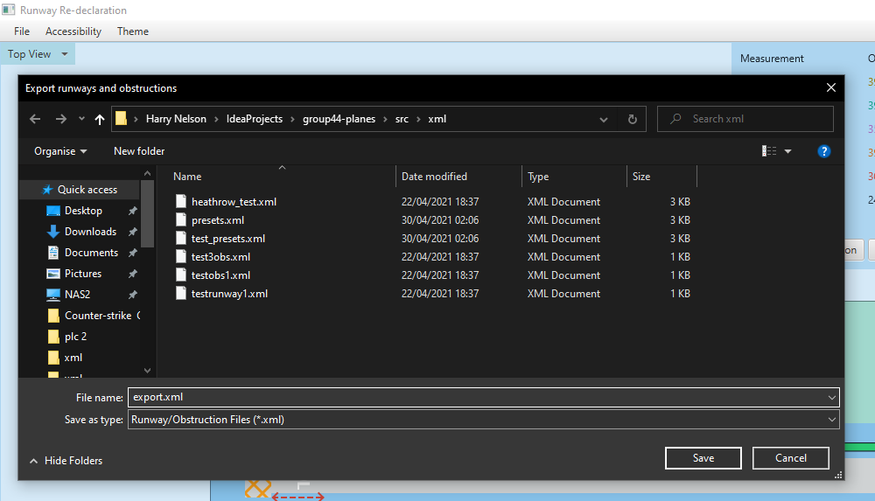
Value + Fit For Purpose
Can import/export runway and obstruction configurations

Slide 5
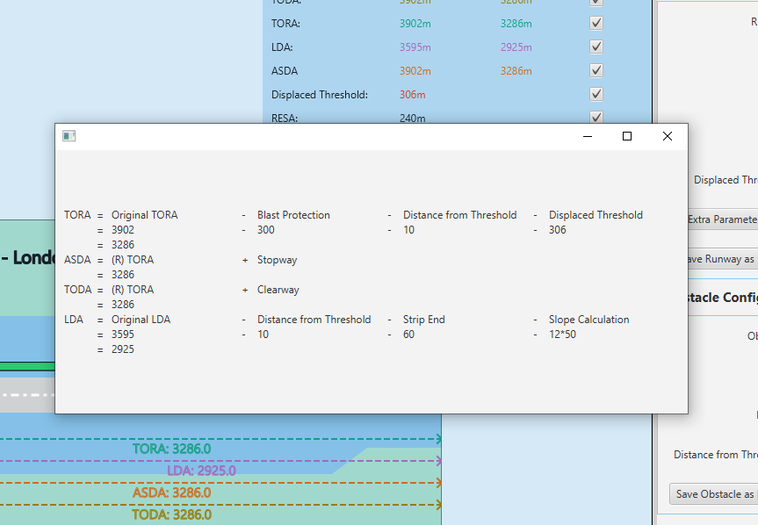
Value + Fit For Purpose
Can view broken down calculations to verify and compare with manually done ones.

Slide 6
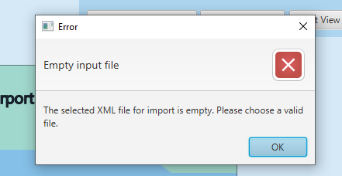
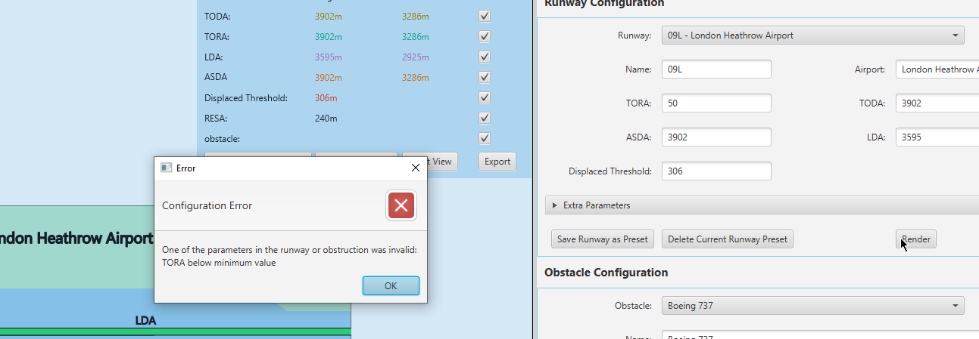
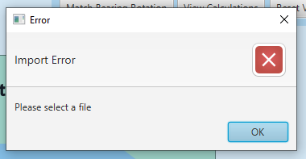
Good User Experience
Helpful error messages upon mistakes

Slide 7
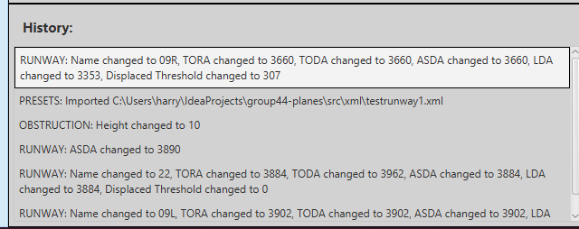
Good User Experience
Log of changes so you can stay up to date on the state of the runways/obstructions

Slide 8
Meets Requirements:
Has met requirements 1-14
Has also met optional requirements 2, 4 & 6

Slide 9
User Guide

Slide 10
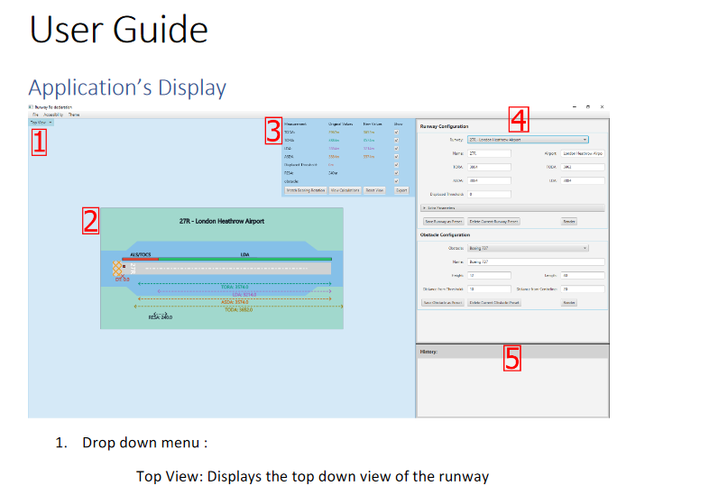
Clear, Concise, User Centred
(Document in documentation folder)

Slide 11
Design and Planning

Slide 12
Previous Planning Documentation

Slide 13
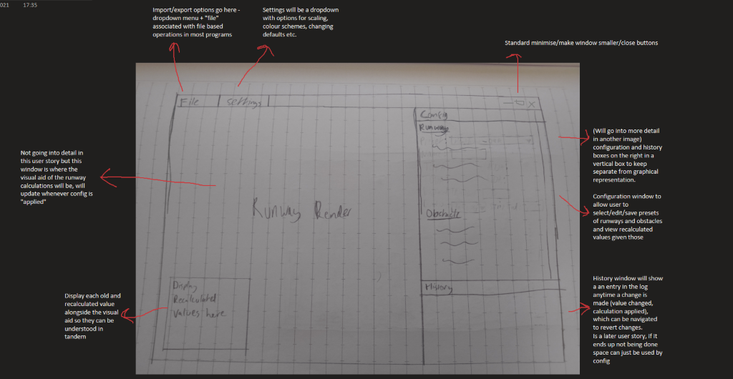
Storyboards
General storyboard/plan for tool GUI

Slide 14
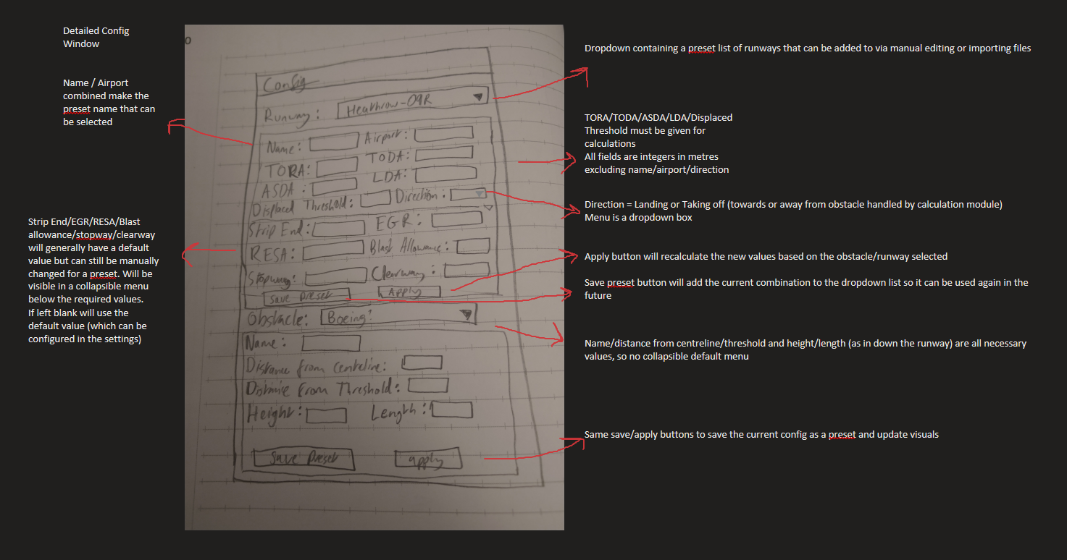
Storyboards
Storyboard for Config Panel

Slide 15
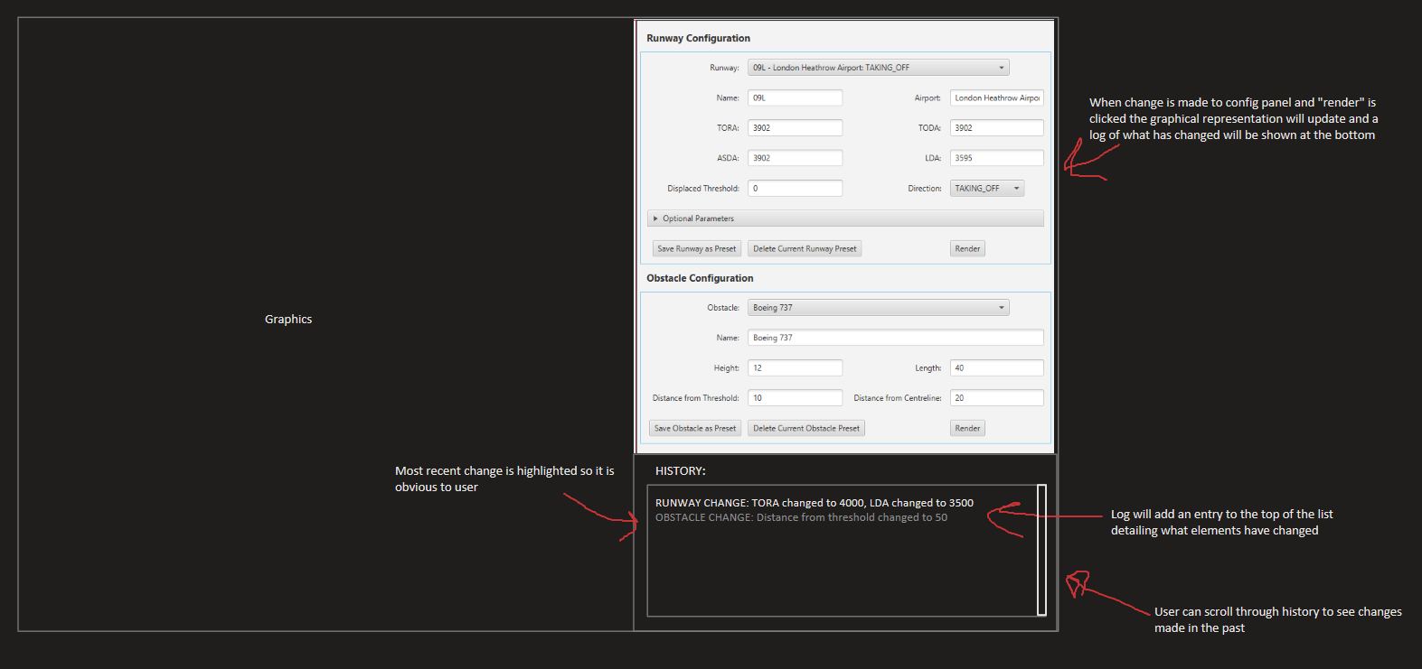
Storyboards – History Log

Slide 16
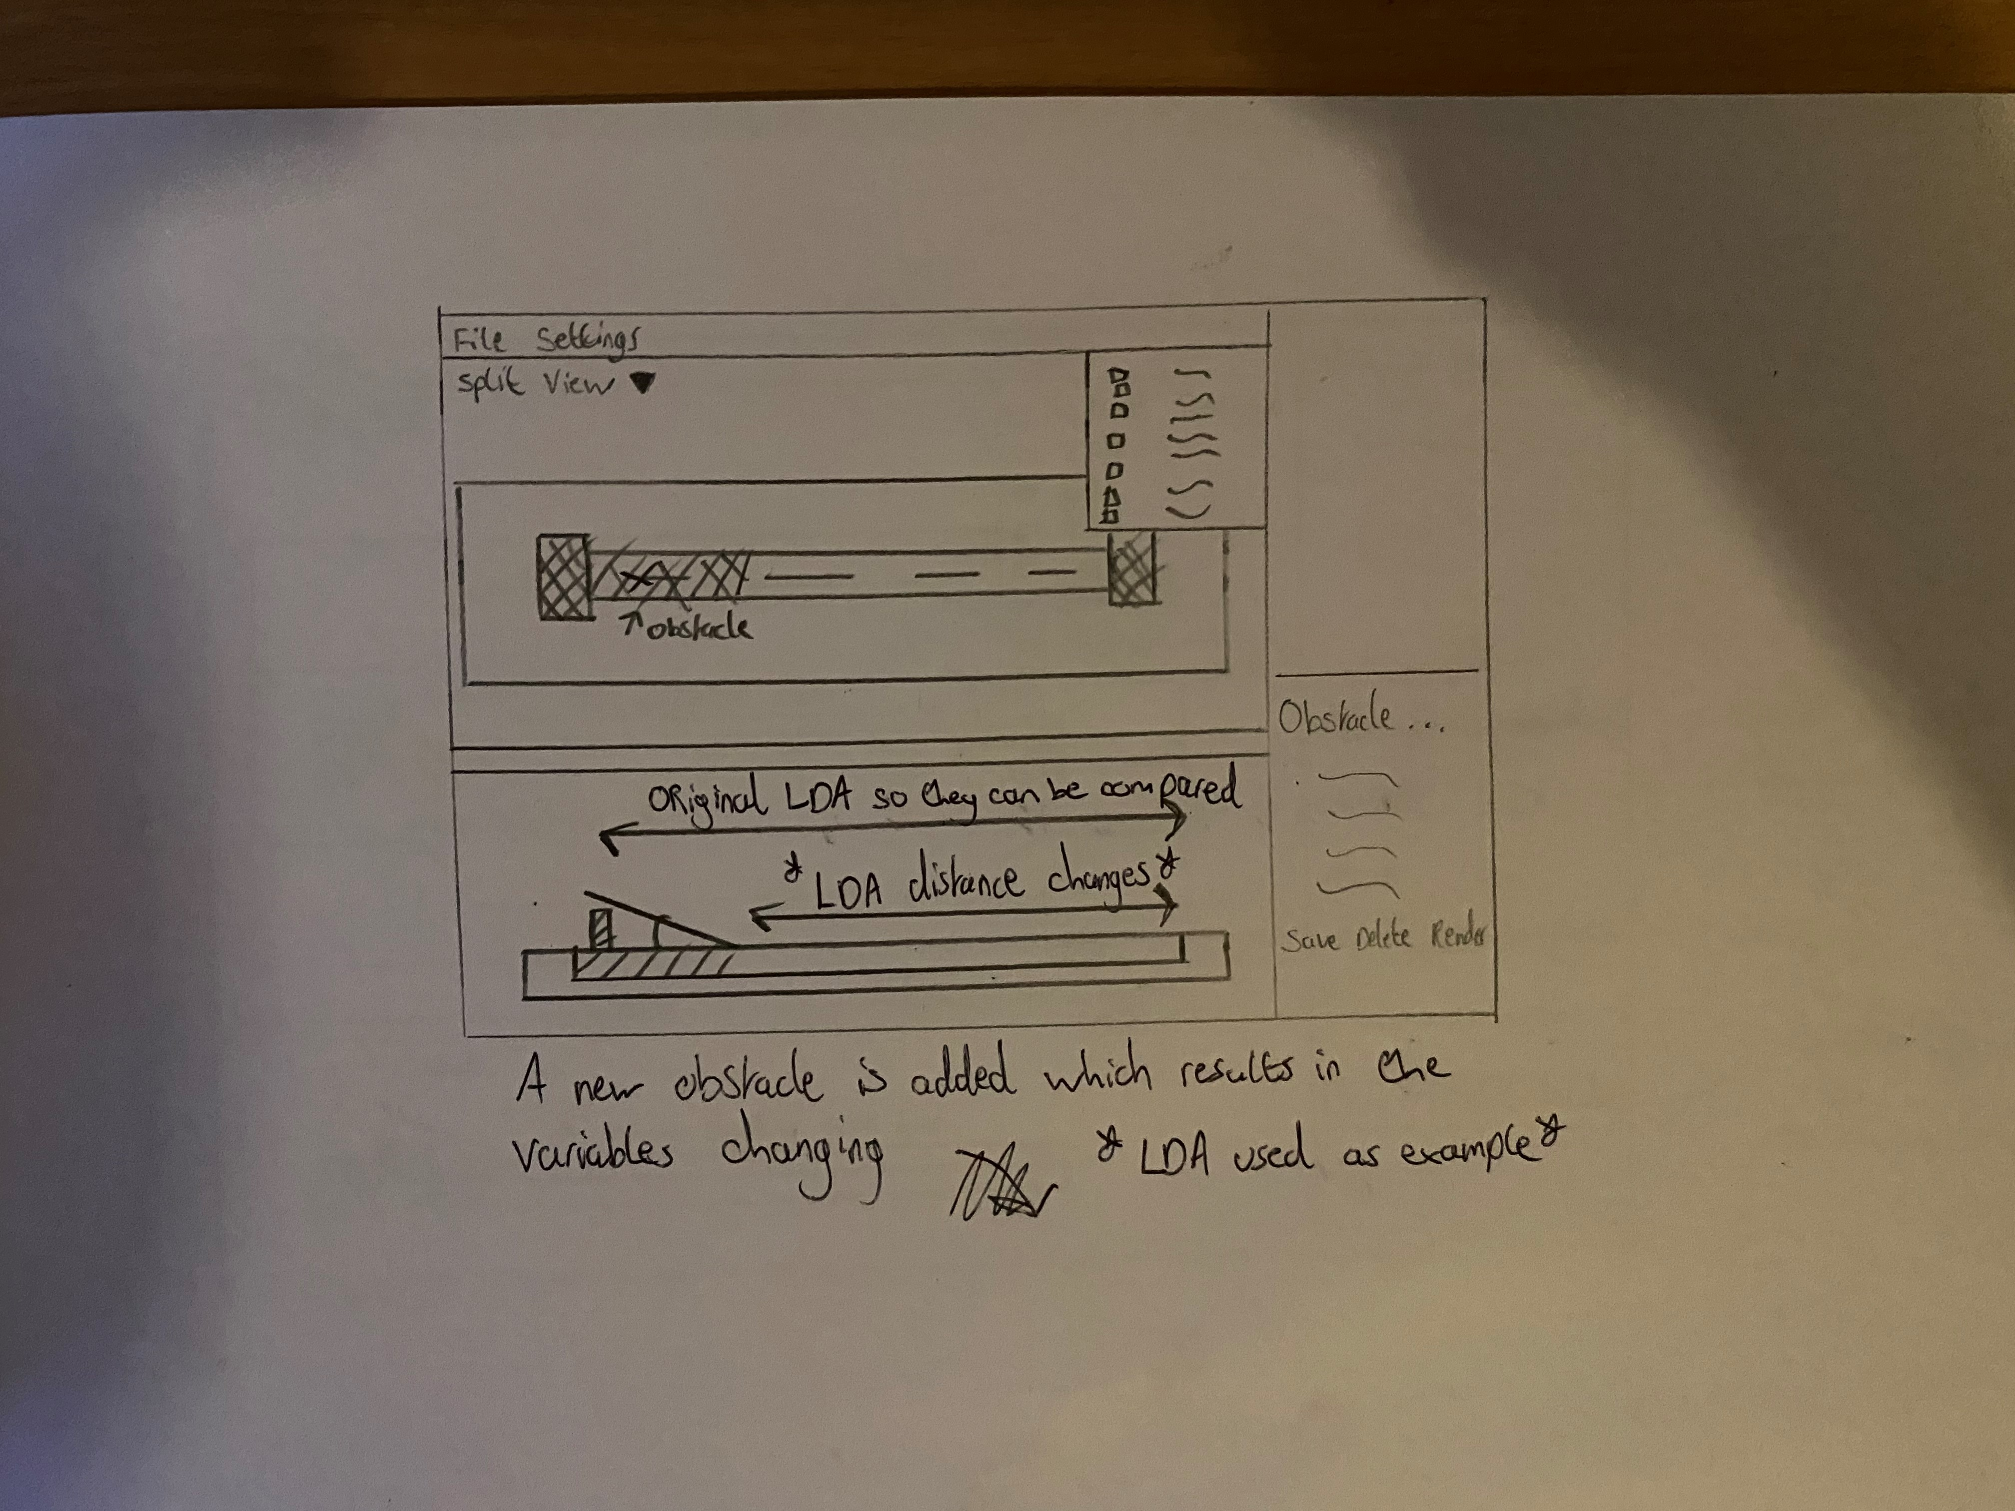
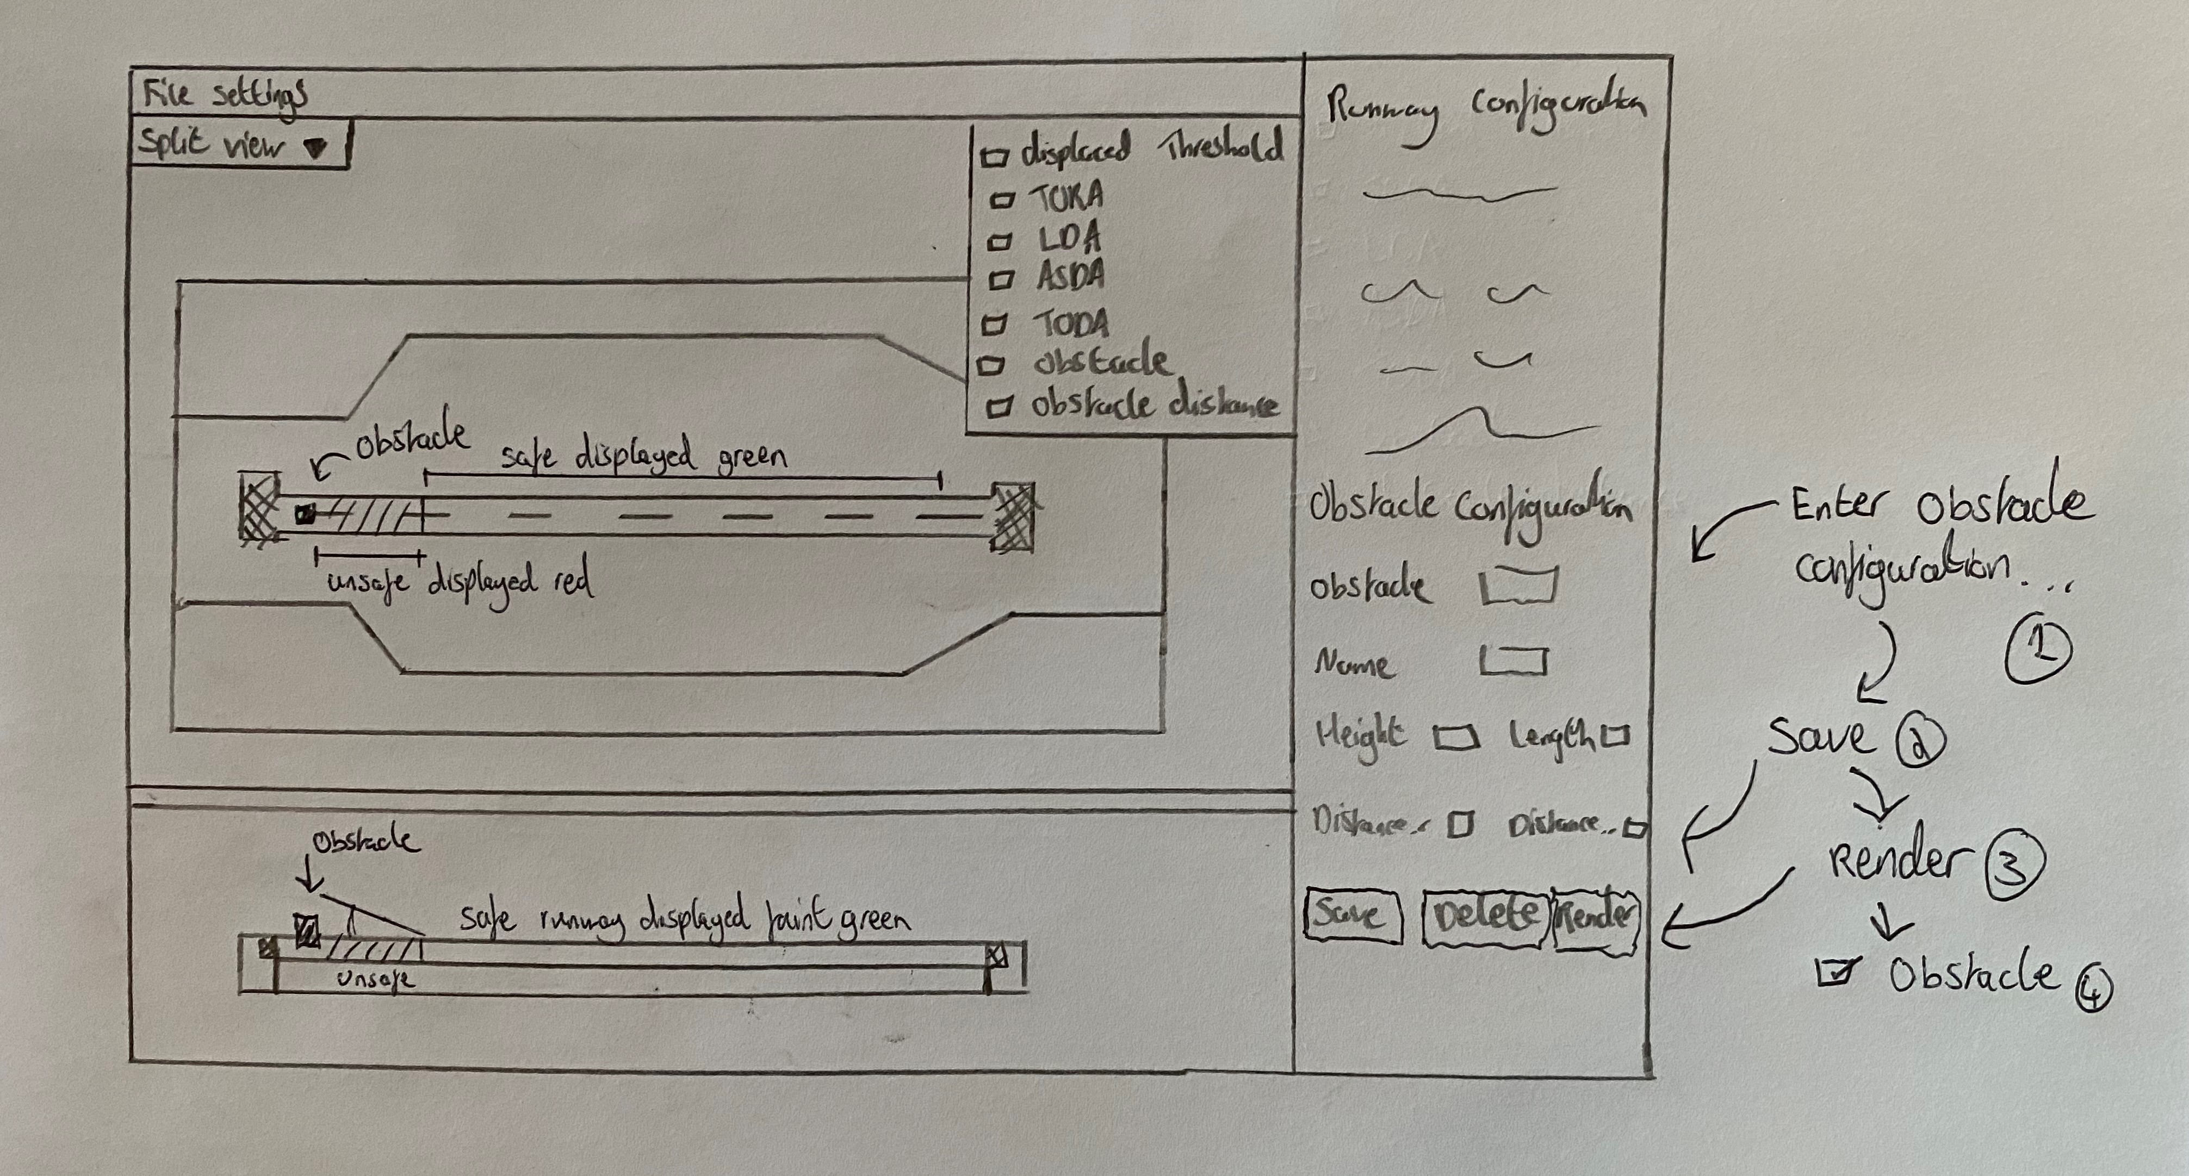
Storyboards – showing calculations

Slide 17
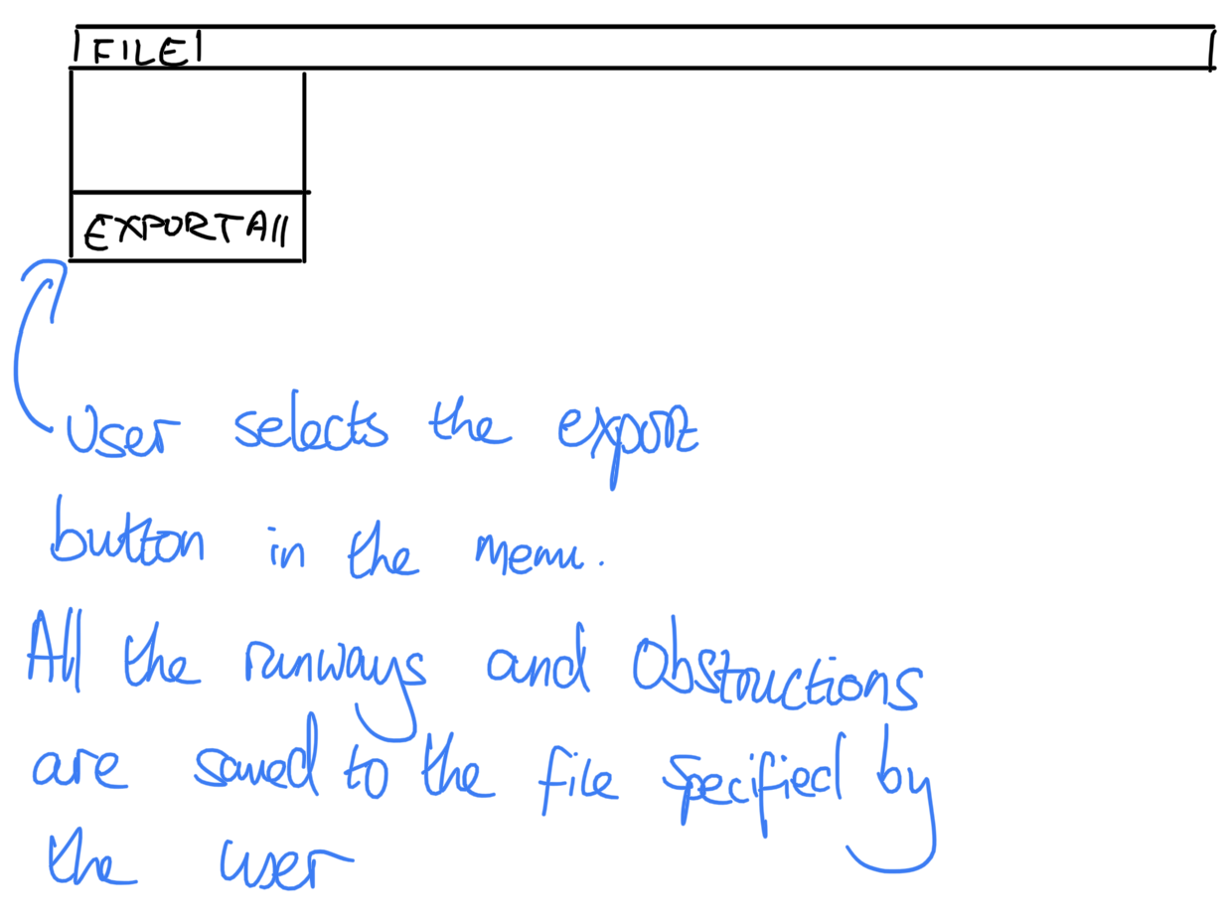
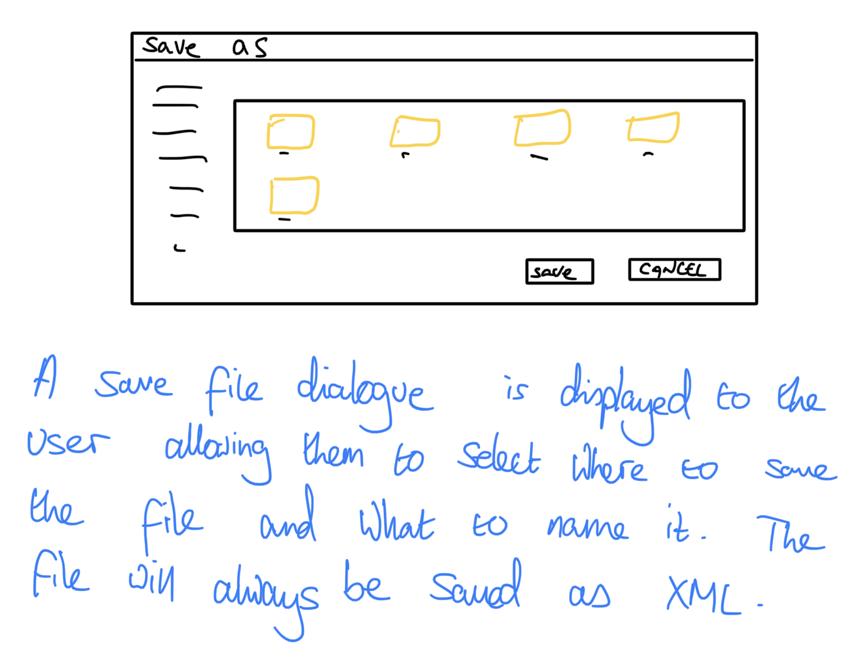
Storyboards – exporting data

Slide 18
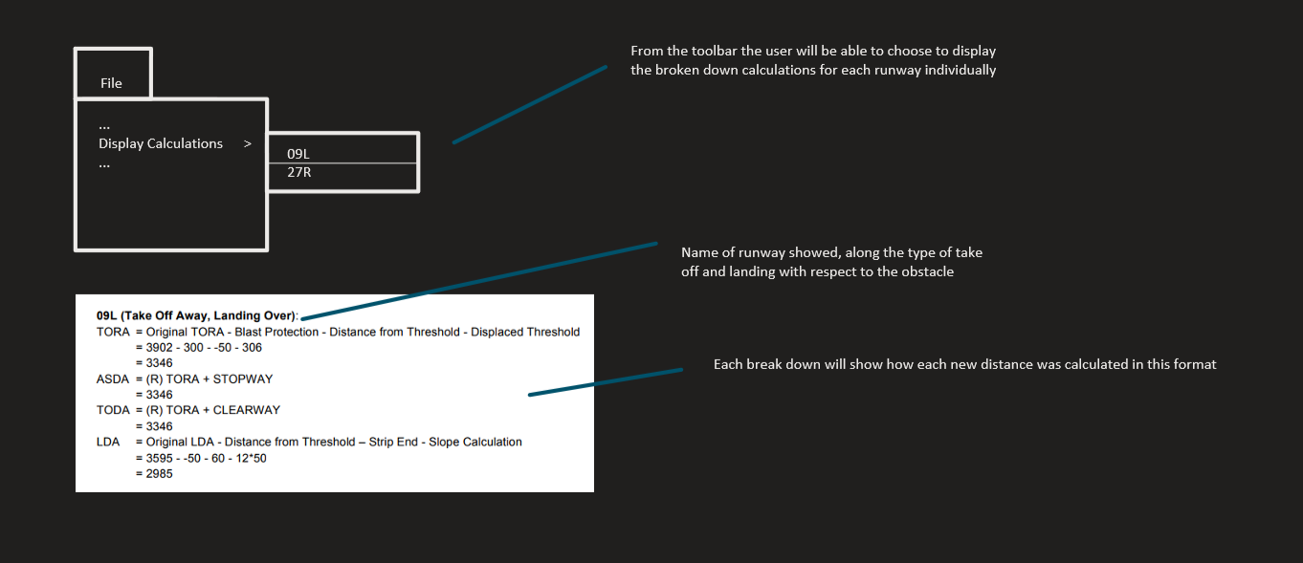
Storyboards – viewing broken down calculations

Slide 19
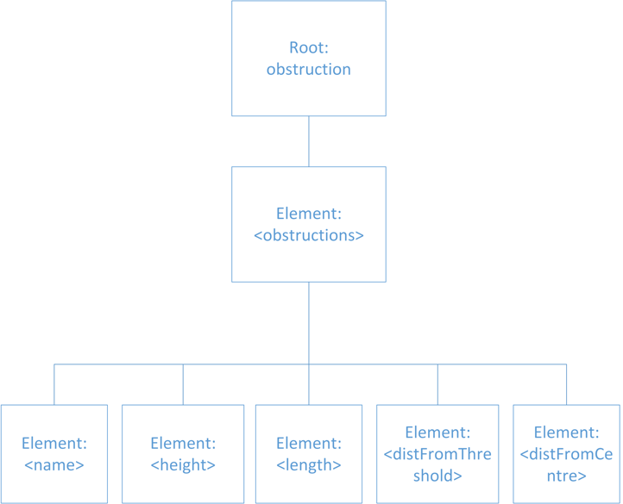
Design – Design Choices
Tree diagram for Obstruction XML files

Slide 20
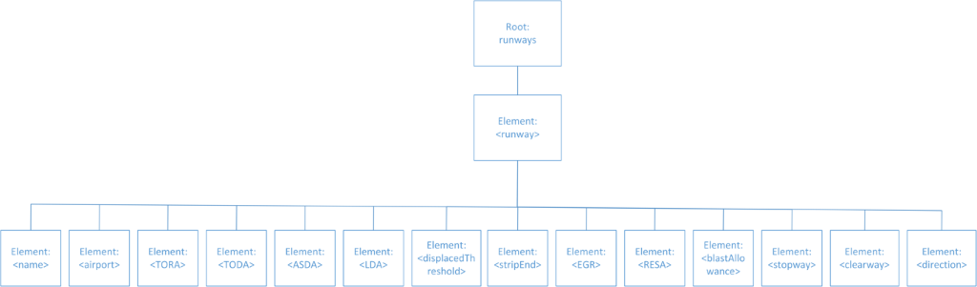
Design – Design Choices
Tree diagram for Runway XML files

Slide 21
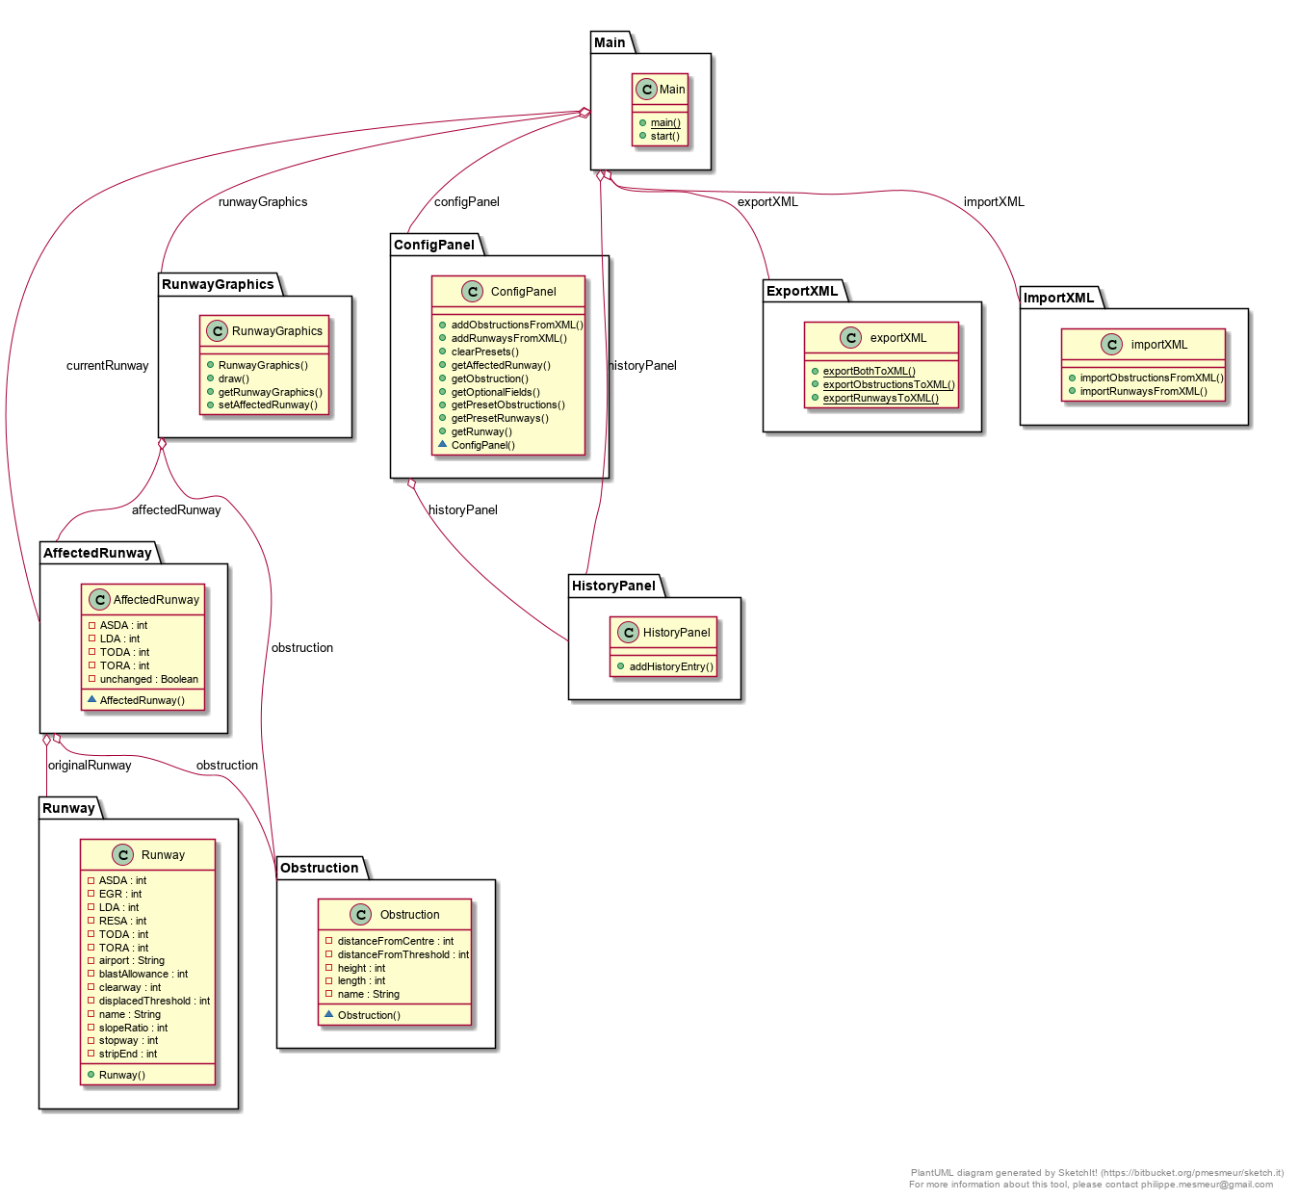
Old Class Diagram

Slide 22
Newer Planning Documentation

Slide 23
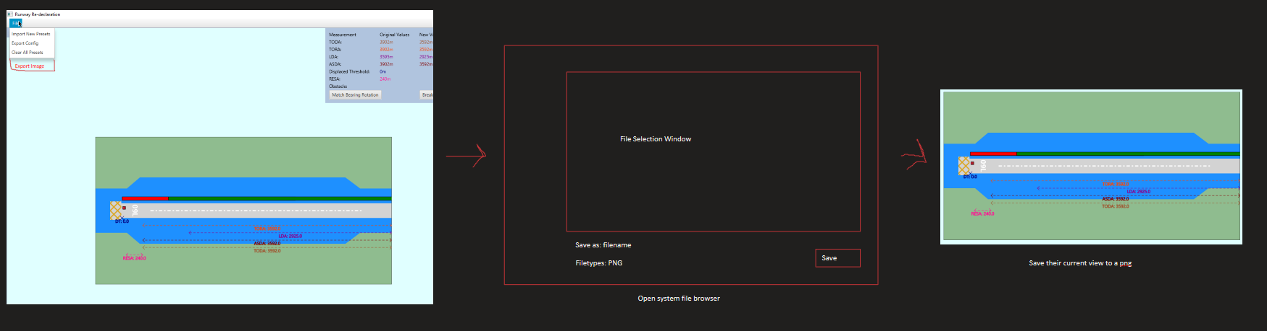
Storyboard – exporting to png

Slide 24
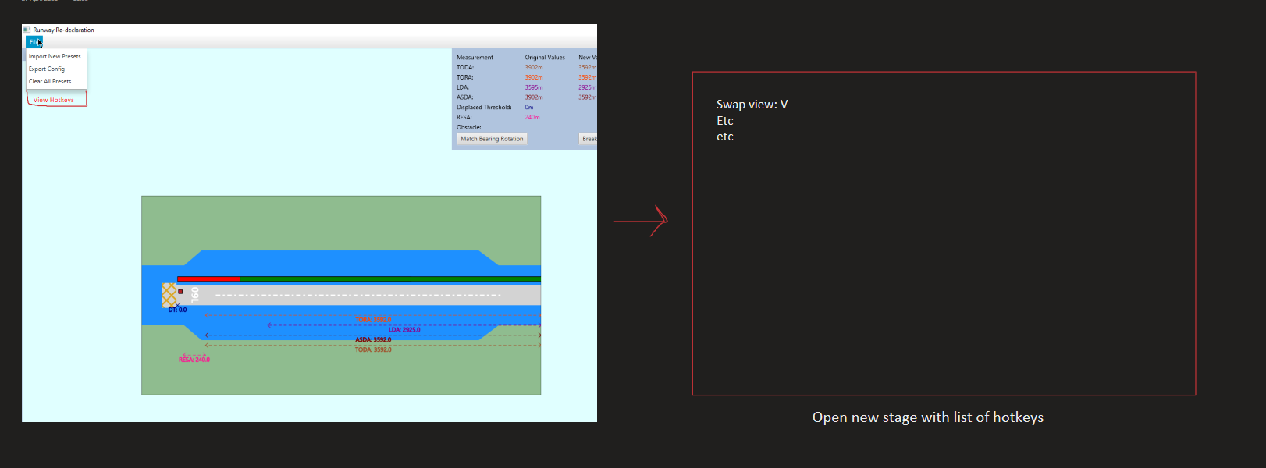
Storyboards - Hotkeys

Slide 25
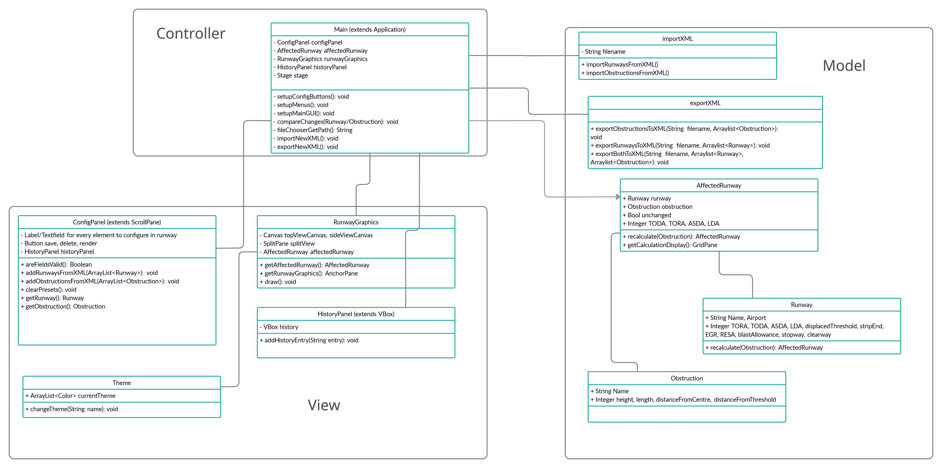
New class diagram sorted into MVC

Slide 26
Scenarios
User Story 1,2,3,5 and 8 - Using the Tool:
  Rob has received a report of a Boeing 737 at one end of runway 27R
  He selects 27R from the runway presets and Boeing 737 from the obstacle presets
  He adjusts the position of the obstacle if it differs from the preset value
  He presses the button to view the new calculations and the graphic of the runway updates to show the runway, the obstacle, and all recalculated values
  A history log shows the changes that have been made since the last time something was rendered (so new runway and new obstacle)
  He then chooses to see a broken-down view of the calculations so they can be compared to his colleague's manually calculated values.
  He sees they line up and are correct and so makes the call to adjust the working area of the runway.
User Story 4 - Importing Presets:
  Rob has started work at a new airport and is setting up the tool on his personal computer.
  He opens the tool and clears the existing presets.
  The configuration fields all clear and saved presets from the airport he used to work at are removed.
  He then tries to import existing data from XML and selects a list of runway/obstacle presets in XML to import.
  The xml file gets imported and its file path is shown in the history.
  The configuration fields fill with information from the imported file, and all the runways and common obstacles are available to select from the preset menu.

Slide 27
Scenarios
User Story 4 - Adding New Presets:
  Rob receives a report about an obstacle (12m tall, 12m wide, 3646m from the 27R threshold, and 0m from the centreline) on runway 27R at Heathrow, the airport he works at.
  Rob opens the tool and sees the runways from his airport available to choose from.
  Rob selects runway 27R from the existing presets.
  The fields fill in with the correct values for that runway.
  Rob inputs values to create a new obstacle and saves it.
  The obstacle is now added to the list of presets.
User Story 7 - Exporting Data:
  Rob has calculated the new values for the runway, and they are shown on the screen.
  He chooses to export the data (runway, obstacle, and new values)
  A file is created containing all the relevant information in an easily parse-able format (probably XML)
User Story 4 - Incorrect Preset Creation:
  Rob is creating a new runway but accidentally mistypes an E instead of a 3 into the TORA parameter and doesn't notice.
  When he tries to save it, an alert appears telling him that the runway parameters are incorrect.
  He goes back and changes the value to be correct and tries again.
  The runway saves correctly and can be seen from the preset list.

Slide 28
Scenarios
User Story 4 - Incorrect Import of Presets:
  Rob tries to import a list of presets but doesn't know that the file has a syntax error.
  When selecting it, an error dialogue appears telling him that the file can't be read.
  He then fixes the syntax error and tries again, and the file is imported correctly.
User Story4 - Empty Import of Presets:
  Rob tries to import a list of presets but doesn't know that it's empty.
  After selecting it an error dialogue appears telling him that nothing new was added.
  No changes have been made to the preset list.
User Story 8 - Finding mistake in history log:
  Rob sets up a new runway/obstacle combination and renders it.
  He adds some new obstacles and renders those.
  He compares his results for the most recent obstacle with a colleague and they don't line up.
  He checks the history log and sees he's accidentally made a change to the runway's TODA which has skewed his results.
  He corrects the change, and the results are now correct.

Slide 29
Scenarios
User Story 9 – Exporting PNG:
  Rob needs to email the results of a calculation to a co-worker.
  He uses the tool to correctly render the new calculations for the given object.
  He presses the export button and saves the image of the runway to his hard drive.
  He can now send this image to his coworker.
User Story 11 – Accessibility Features:
  Rob uses the tool to view the new calculations, but he is struggling to read the values.
  Rob changes the colour scheme to one that suits his eyes better.
  Rob can now read the values and decide about the keeping runway open.

Slide 30






Planning – Changes to Increment 3 Plan
ID | User Story | Tasks (Product Backlog) | Weight
6 | As an Airside Operations Duty Manager I want to view the calculations graphically so the effects can be more easily understood. | display calculated predictions graphically on top of the top / side views of the airway | 3
 |  | Add options to customize said graphic | 2
9 | As an Air-side Operations Duty Manager I want to be able to export the visualisations in common image formats / document formats so they can be shared internally in the airport more easily. | Allow for exports of airway view with calculation visualisations basic image formats (png, jpg) basic document formats | 3
 |  | Give user filters over what to show / not show | 2
10 | As an Airside Operations Duty Manager I want to have the calculations overlaid on real-world images of the runways so I can visualise them more easily. | Allow the change between graphical representation and real world images | 1
11 | As an Airside Operations Duty Manager I want the tool to interface with assistive technologies so I can use the tool despite my disabilities. | Allow for greater control over the GUI Font sizes Colourblind mode | 2
 |  | Add key mapping setting, for the use of specific keyboards | 2
 |  | Make software not mouse/keyboard dependent | 3
12 (new) | The program should behave correctly. This task has been introduced in this increment (increment 2) to account for finding and fixing any bugs, particularly those that have only arisen when integrating the different parts of the system into one product. | Clear values in the legend area when no runway data is active | 1
 |  | Handle starting program with no presets correctly | 2
 |  | Find and fix any other integration issues and bugs that have arisen during development | 4
Notes:
Added task 12 to accommodate for some new bugs identified late in this sprint

Slide 31
Planning – Changes to Increment 3 Plan
Misjudged weight of stories 6 and 10:
  For 6 we had far less to do than expected
  For 10 it was a lot more work for relatively little value than expected
Removed stories 6 and 10 from plan
Changed story 9 to have tasks:
  Add button to export a PNG of the currently displayed runway + calculations
  Allow for selection of JPG when exporting image
Changed story 11 to have tasks:
  Add ability to change sizes of text on graphic
  Allow user to change colours of elements of graphic
  Add colour scheme themes for user to choose between
  Add hotkeys for specific functionality of GUI so it relies less on mouse use
  Add button to menu to list all hotkeys available
Changed story 12 "fix bugs" task to be more specific:
  Fix issue with values being shown incorrectly when obstacle over specific threshold on runway
  Fix issue with obstacle not being shown at end of displaced threshold
  Fix XML importing incorrectly with only runways or only obstacles
  Create tests/scenarios for other stories + fix any issues that affect functionality and value significantly that arise
Notes:
Added task 12 to accommodate for some new bugs identified late in this sprint

Slide 32
Changes based on Feedback:
Added ability to customise colour schemes as they were hard to see + reworked original colour palette.
Tested colour schemes with online colourblind filters to make sure elements were readable.
Added titles to each view so it was clearer what the user was looking at.
Added labels to ALS/TOCS slope
Re-created class diagram to be clearer
Broke down some tasks and re-prioritised to consider reduced sprint length + not allow for un-completable tasks (e.g., "fix bugs")
Included fewer specific examples of the program fulfilling our scenarios

Slide 33
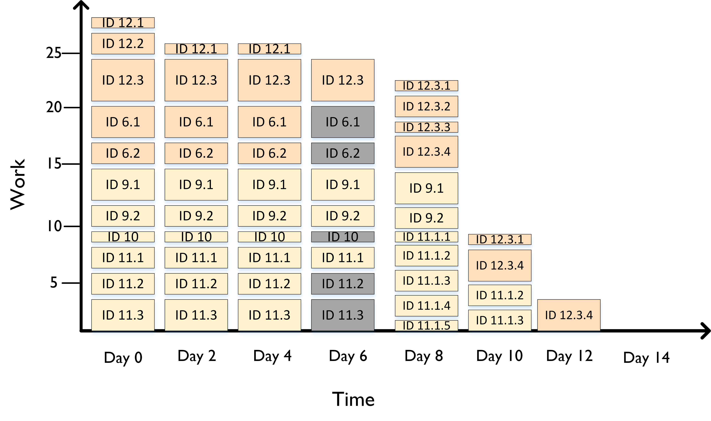
Planning – Increment 3 burndown chart
Grey indicates a task was removed
Changes to plan structure mid-sprint following supervisor meetings
Notes:
Based on previous supervisor meeting, we split the burndown chart into individual tasks from each user story

Slide 34
Testing

Slide 35
Automated Testing
Automated Unit testing performed for User Input, Exporting / Importing and calculations using scenarios 1 - 4 from the given examples.The tests include boundary and partition testing and have been repeated after every increment.
Scenarios used for automated tests:
Scenario 1 = 12m tall obstacle, on the centreline, 50m before the 09L threshold, 3646 from the 27R threshold.
Scenario 2 = 25m tall obstacle, 20m south of the centreline, 500m from the 27L threshold and 2853m from 09R threshold.
Scenario 3 = 15m tall obstacle, 60m north of centreline, 150m from 09R threshold and 3203m from 27L threshold.
Scenario 4 = 20m tall obstacle, 20m right of centreline, 50m from 27R threshold and 3546m from 09L threshold.

Slide 36
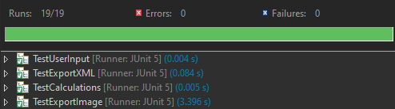
Automated Testing
TestUserInput contains automated validation tests for all values input by the user, testing around boundaries and incorrect values.
TestExportXML performs export and import tests on the scenarios, testing that the files are created and then the imported values are correct.
TestCalculations tests the recalculation values on the scenarios, comparing them to their true values.
TestExportImage exports Top and side views for each scenario and checks the file existence, manual checking of the created files is then required to check for correctness of the image. (ExportToJPG fails however in our manual testing it does successfully create the image, was unable to fix before deadline)

Slide 37
Manual User Story Scenario Testing
(1, 2, 3, 5, 8) User Story Scenario Using the Tool = Select Runway 27R and object Boeing 737 from default pre-sets. Adjusts obstacle position, render new runway view, press view calculations
  Result = Runway with calculations show, history log shows changes between renders, view calculations show correct calculations
(4) User Story Scenario Importing Pre-sets = Clear existing pre-sets, import existing pre-sets from xml
  Result = Configuration fields clear, xml imports correctly
(4) User Story Scenario Adding New Pre-sets = Select Runway 27R, create new obstacle 12m tall, 12m wide, 3646m from the 27R threshold, and 0m from the centreline, save object as pre-set
  Result = Obstruction is created and then is saved to list of pre-sets
(7) User Story Scenario Exporting Data = export set of given pre-sets
  Result = File is created and shows correct values when imported
(4) User Story Scenario Incorrect Pre-set Creation = mistype letter in number parameter of TORA, fix mistype and attempt to re save
  Result = Error message shown, saves pre-set correctly and is visible in list loads once selected

Slide 38
Manual User Story Scenario Testing
(4) User Story Scenario Incorrect Import of Pre-sets = Syntax error in importing pre-set file
  Result = Error message visible and no import attempted
(4) User Story Scenario Empty Import of Pre-sets = Empty list of pre-sets
  Result = Error message visible and no import attempted
(8) User Story Scenario Finding mistake in history log = create new Runway and obstacle, add new obstacles, check history to see a previous TODA change, correct change
  Result = History updates correctly
(9) User Story Scenario Exporting to PNG = render calculations and export to png
  Result = Image is created and saved, manual viewing shows correct image
(11) User Story Scenario Accessibility Features = Change colour theme
  Result = Colour theme changes correctly and the colour passes colourblind image test

Slide 39
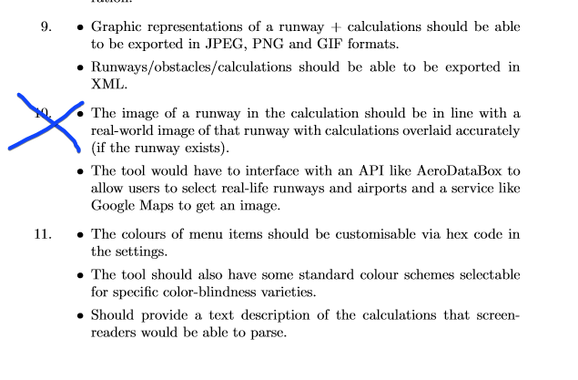
Acceptance Criteria Changes
Decided against completing user story 10 due to difficulty compared to lack of value provided
Second element of user story 9 was already completed in user story 6 but not updated
Changed requirements for menu colour to use pre-selected colour schemes that we knew were colourblind compliant
Replaced text description requirement as it would be relatively unhelpful without a means of accurately navigating the menu without visibility, which was outside the scope of what we thought was possible this sprint
Added a new requirement for aid navigating the tool without a mouse to have some keybinds for functionailtiy in the tool.

